Slide 1
Raw Socket
Dr. Geetha V.
Assistant Professor
Dept of IT,
NITK Surathkal

Slide 2
Index
Ethernet Frame format
IP header format
TCP header format
Raw socket program in C

Slide 3
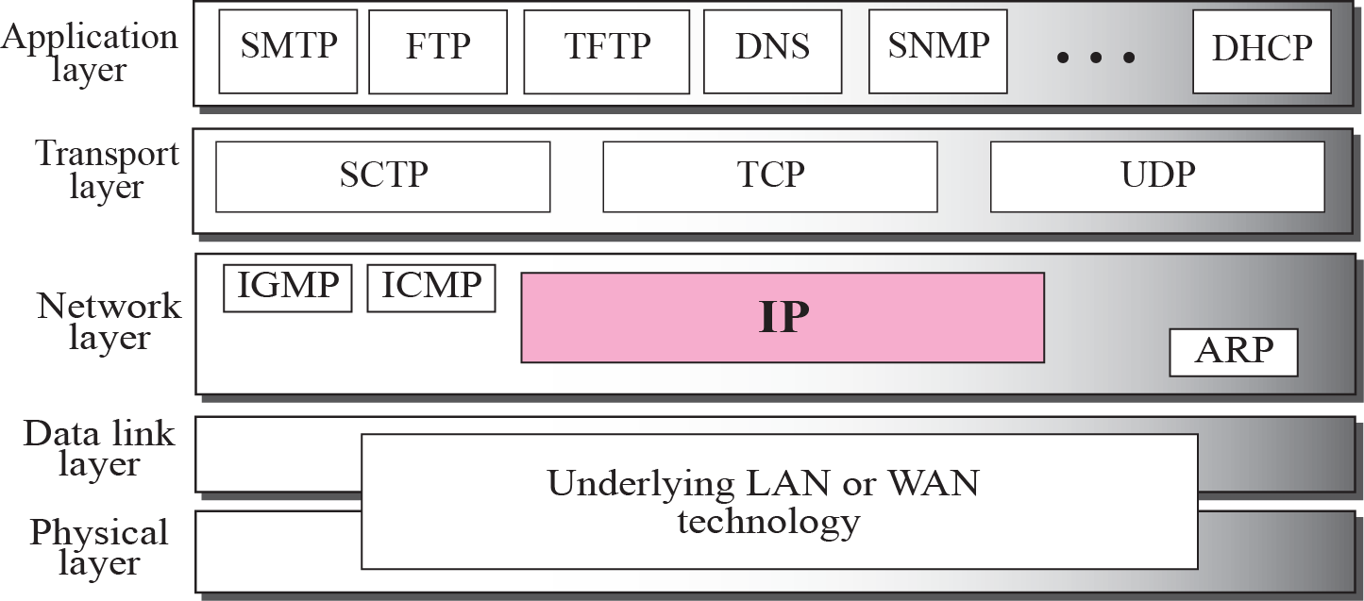
Protocol Stack

Slide 4
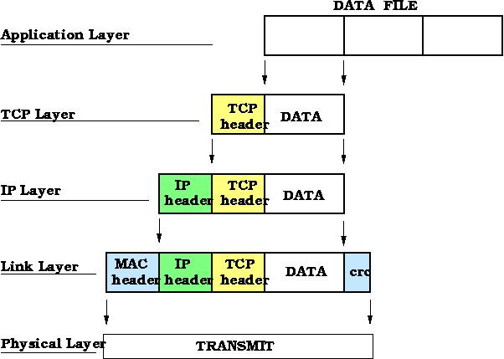
Ethernet, IP, TCP header

Slide 5
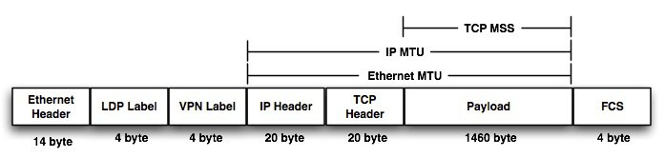
Ethernet, IP, TCP header

Slide 6
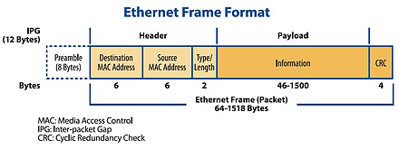
Ethernet Frame Format

Slide 7
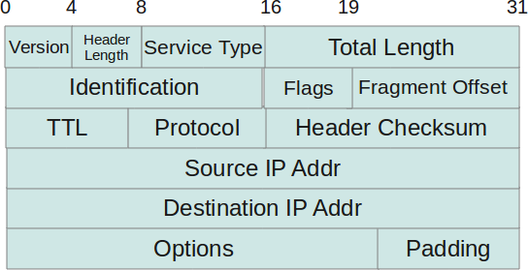
IP header format
Version: 4 HL: min 5, ToS: precedence, delay, throughput, reliability TL: length of full IP datagram.

Slide 8
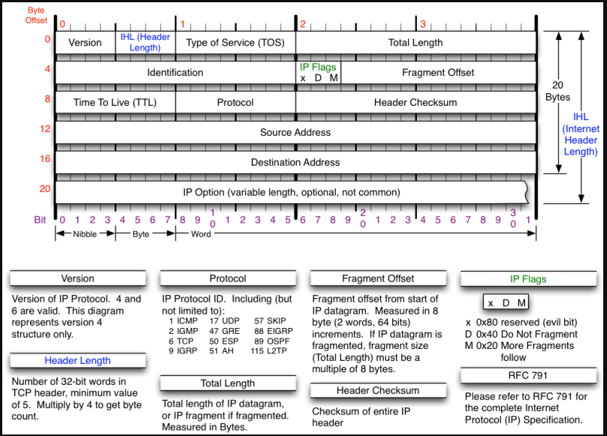
IP header

Slide 9
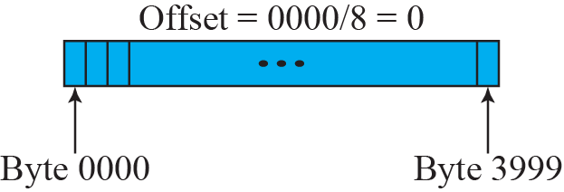
Fragmentation example

Slide 10
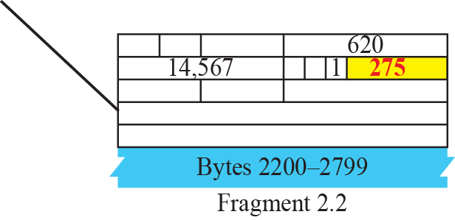
Detailed fragmentation example

Slide 11
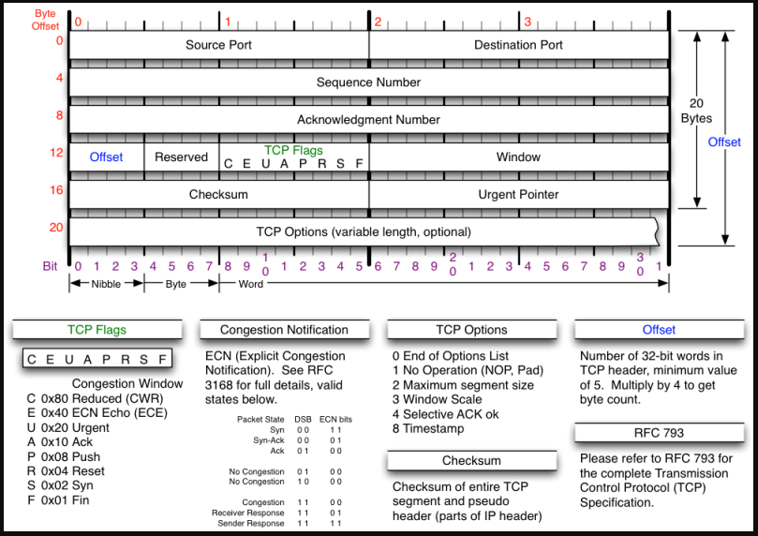
TCP header format

Slide 12
Receiving raw socket
int sock_raw=socket(AF_PACKET,SOCK_RAW,htons(ETH_P_ALL));
data_size = recvfrom(sock_raw,buffer,65536,0,&saddr,(socklen_t*)&saddr_size);

